Slide 1


AI -ASSISTED LUNAR TERRAIN ANALYSIS &
SAFE ROVER NAVIGATION
Team Chandra
Presented By -
TIRTHAPADA PANDA
ASHRITA BEHERA
SWAGATAM PRADHAN
RR HIMANSHU SEKHAR DAS
Next

Slide 2
Content :
Lunar AI: Intelligent Landing Site Selection & Rover Navigation
End-to-End AI Pipeline: From Image to Decision
Five Core Modules
System Architecture
Feature Set & Development Roadmap
Working Methodology
Dashboard UI — Mission Intelligence at a Glance
Expected Impact
Future Scope
Technical Feasibility
Implementation Timeline
Conclusion

Slide 3
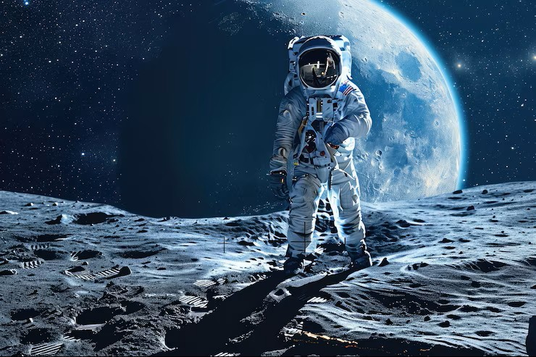
Lunar AI: Intelligent Landing Site Selection & Rover Navigation
An AI-powered system that analyzes lunar satellite imagery, detects terrain hazards, recommends the safest landing zones, and plans optimal rover paths — built for the next era of Moon and Mars exploration.

Slide 4
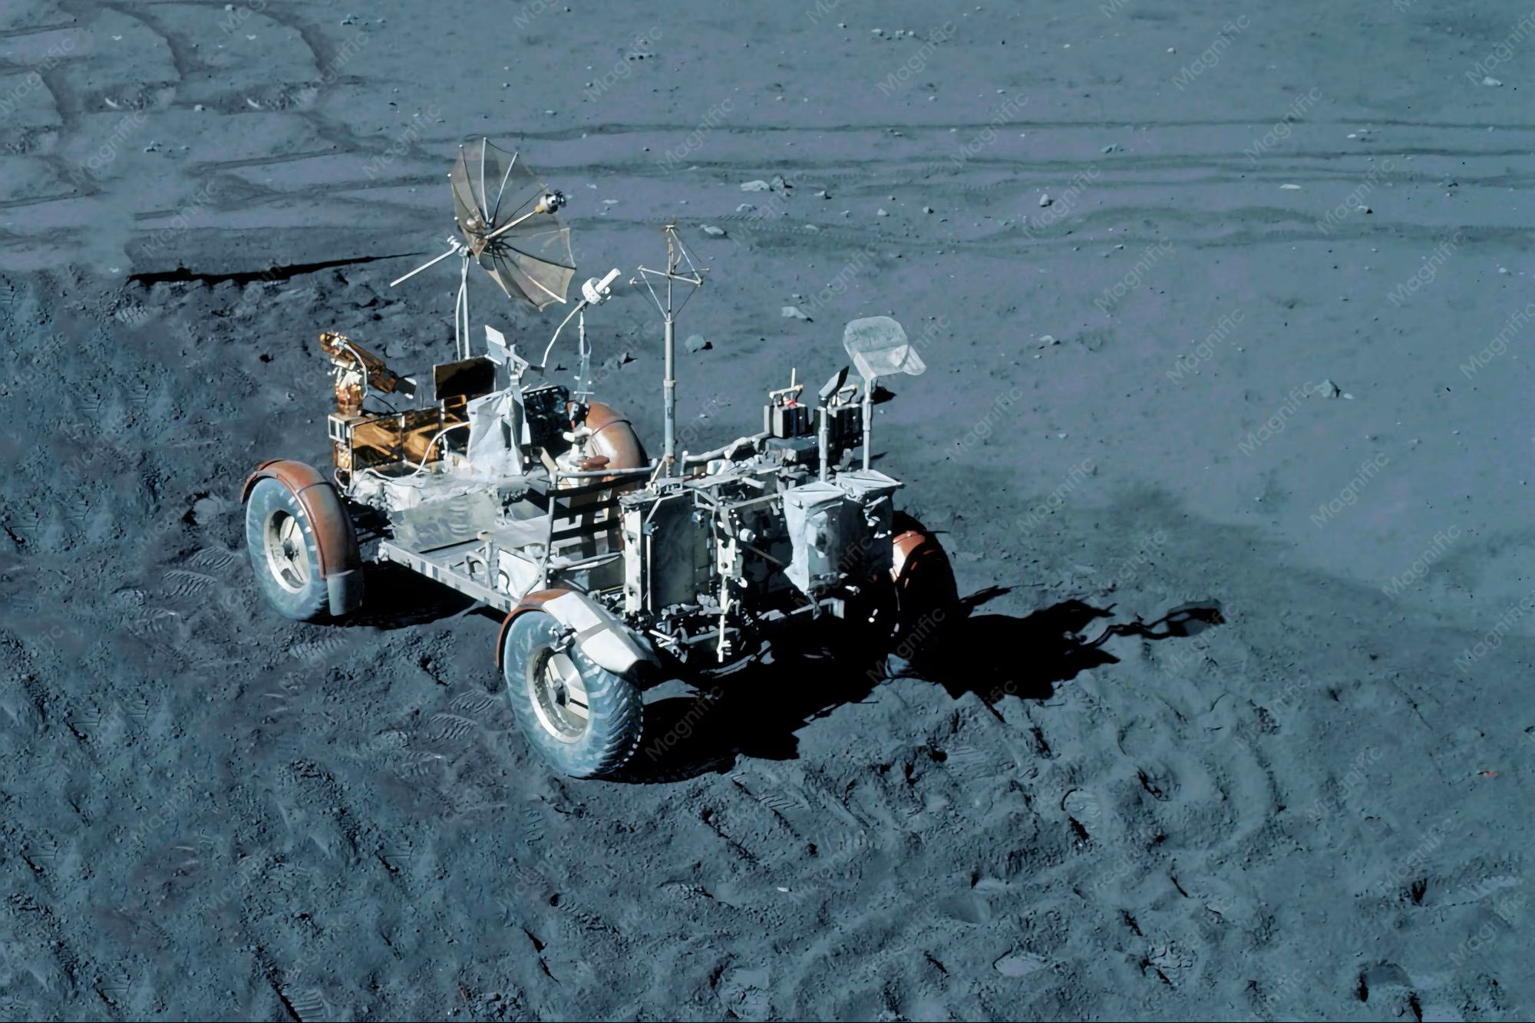

Why Landing on the Moon Is Harder Than It Looks
Terrain Hazards
Craters, boulders, steep slopes, and regolith make manual landing site selection extremely risky. A single misjudgment can destroy a mission.
Manual Analysis Is Too Slow
Human experts analyzing satellite imagery take hours or days — far too slow for autonomous or time-critical missions.
An AI-assisted, real-time system is essential for safe, scalable lunar exploration.

Slide 5
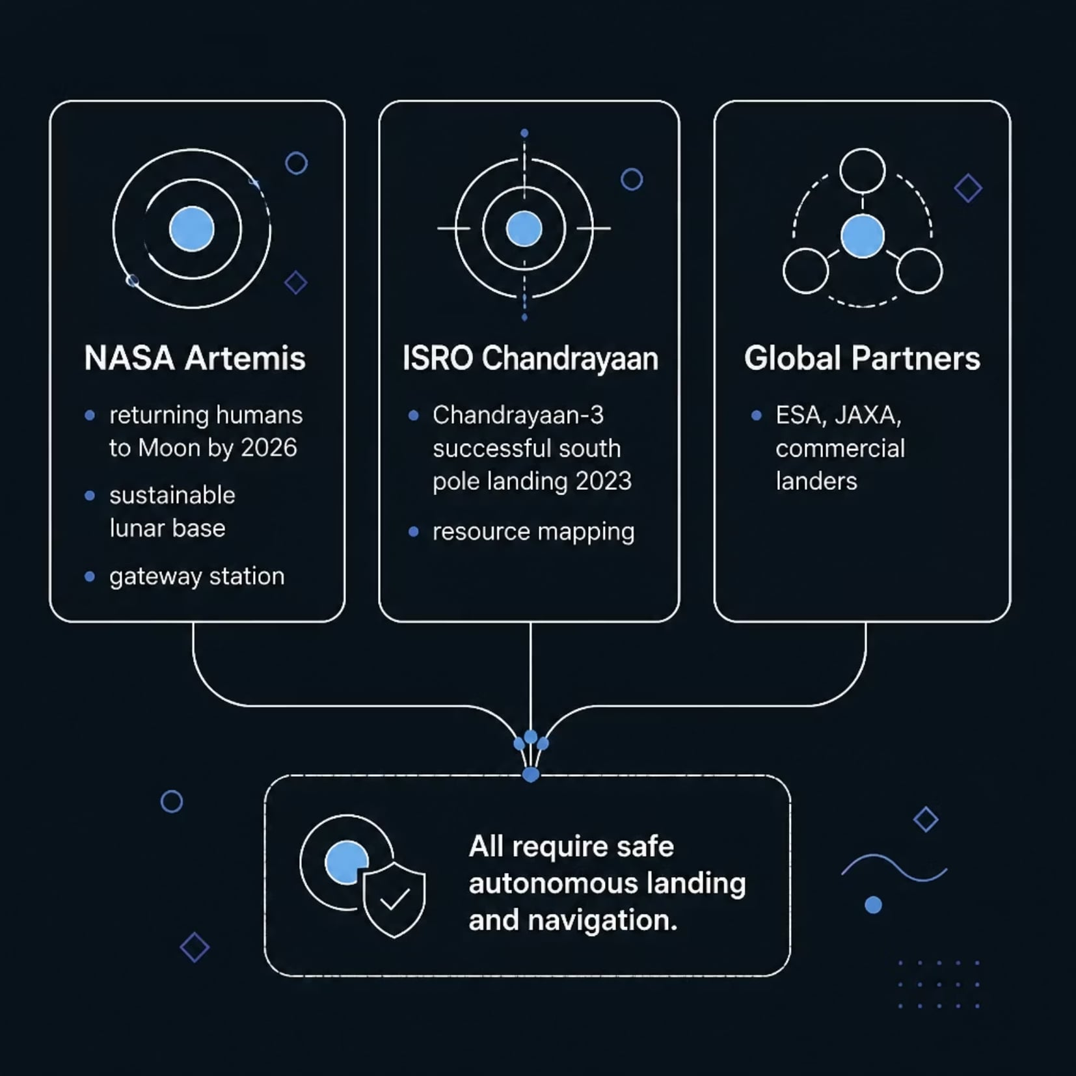
The Moon Is Back — And the World Is Racing
Why This Matters Now
NASA's Artemis Program and ISRO's Chandrayaan missions have reignited global lunar exploration. Safe, autonomous landing and navigation are no longer optional — they are mission-critical requirements.
Artemis III targets crewed south pole landing by 2026
ISRO planning Chandrayaan-4 sample return mission
Autonomous navigation reduces communication delay risks

Slide 6
What the System Must Do
Analyze Lunar Images
Detect Craters & Rocks
Terrain Classification
Process high-resolution satellite imagery of the lunar surface
Identify surface hazards including craters, boulders, and debris
Classify slopes, flat zones, and dangerous terrain types
Recommend Landing Zone
Rover Path Planning
Generate hazard maps and recommend the safest landing area
Compute the safest, most efficient traversal route for rovers

Slide 7
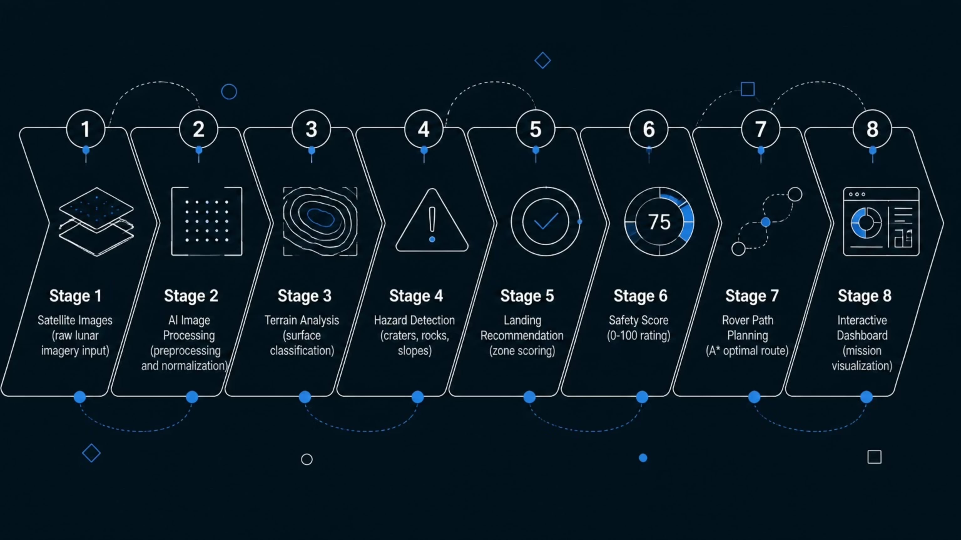
End-to-End AI Pipeline: From Image to Decision
Every stage feeds the next — raw satellite imagery is transformed through AI processing, terrain analysis, and hazard detection into a ranked landing recommendation with a quantified safety score and an optimal rover path, all visualized on an interactive mission dashboard.

Slide 8
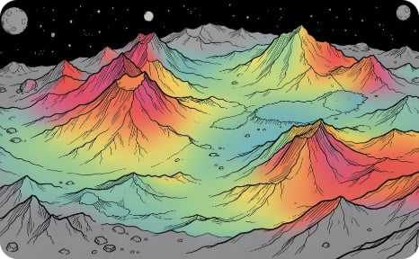
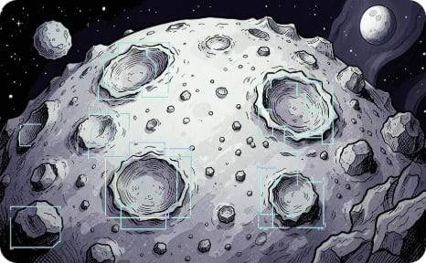
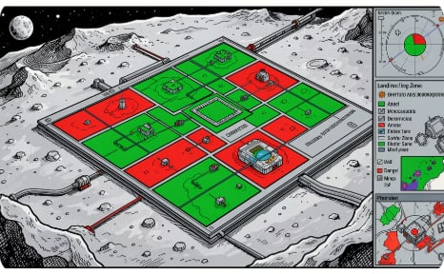
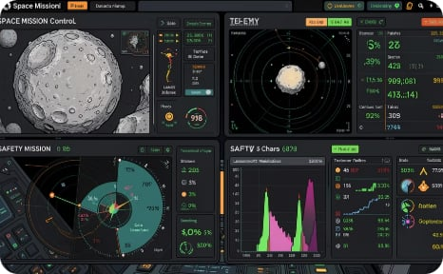
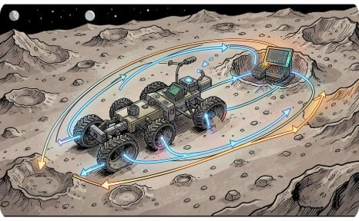
Five Core Modules
Terrain Analysis
Hazard Detection
Landing Recommendation
Classifies surface types — flat, sloped, rough — using elevation and texture data
YOLO-based detection of craters, boulders, and dangerous terrain features
Scores and ranks candidate zones, recommending the safest with explainability
Dashboard Visualization
Rover Navigation
Real-time interactive mission dashboard with hazard maps, scores, and reports
A* algorithm computes obstacle-free, energy-efficient traversal paths

Slide 9
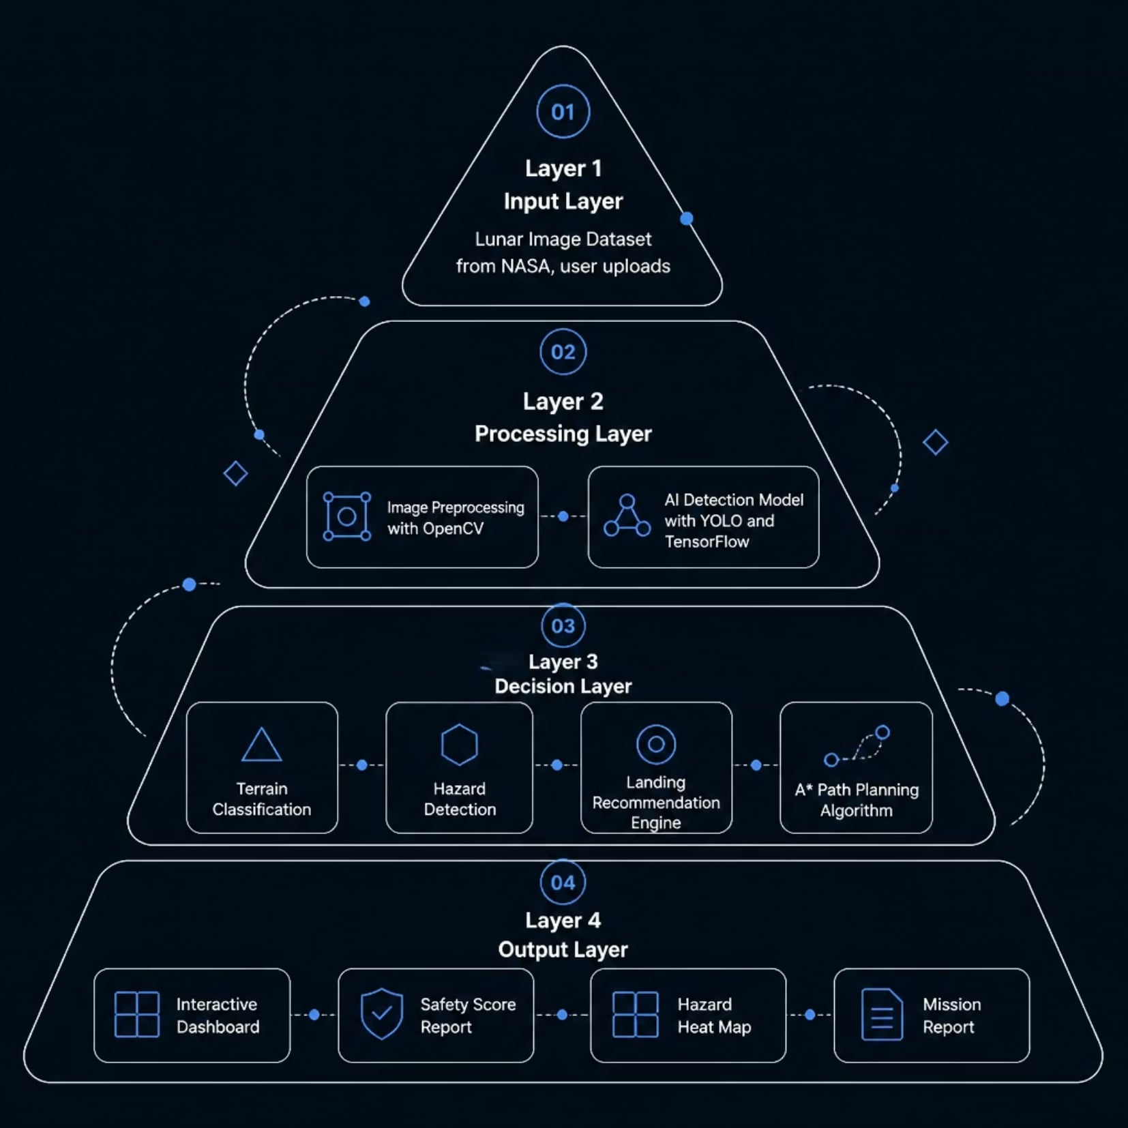
System Architecture
Architecture Overview
The system follows a clean four-layer architecture — from raw data ingestion through AI processing and decision-making to an interactive output layer — ensuring modularity, scalability, and real-time performance.
Input Layer: NASA lunar datasets + user-uploaded imagery
Processing Layer: OpenCV preprocessing, YOLO detection, TensorFlow classification
Decision Layer: Terrain scoring, hazard mapping, A* path planning
Output Layer: Dashboard, safety reports, heat maps, mission summaries

Slide 10
Technologies Powering Lunar AI
Frontend
Backend
AI / ML
HTML · CSS · JavaScript — responsive mission dashboard UI
Python · Flask — lightweight REST API for model serving
OpenCV · YOLO · Computer vision ,
Algorithm
Dataset
A* Path Planning — optimal, obstacle-aware
rover routing
NASA Lunar Reconnaissance Orbiter Camera
(LROC) imagery database

Slide 11
Feature Set & Development Roadmap
Safe Landing Detection
Hazard & Crater Detection
Rock & Terrain Analysis
Safety Score & Heat Map
Rover Route Planning
Interactive Dashboard
Mission Report Generation
From lunar dataset to full mission dashboard — Lunar AI delivers a complete,
production-ready pipeline for autonomous space exploration.

Slide 12
Development Roadmap
Phase 1
1
Dataset collection, preprocessing,
and crater detection model
2
Phase 2
Hazard map generation, safety scoring,
and landing recommendation
Phase 3
3
Rover path planning,
dashboard integration, and testing
4
Phase 4
Moons compatibility, explainability panel,
and final demo

Slide 13
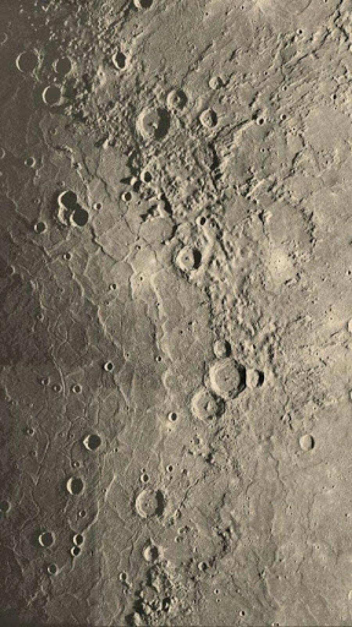
Working Methodology
Our AI pipeline transforms raw lunar imagery into actionable mission intelligence — in nine precise steps.

Slide 14

From Image to Intelligence
User Uploads
AI Preprocesses
Terrain Analyzed
Hazards Detected
Safe Areas ID'd
Each stage is powered by specialized deep learning models — from convolutional neural networks for terrain segmentation to reinforcement learning for optimal path planning. The entire pipeline executes in seconds, delivering mission-ready outputs to operators in real time.

Slide 15
Dashboard UI — Mission Intelligence at a Glance
A unified command interface presenting all critical outputs for rapid mission decisions.
Crater Detection
Rock Hazard Map
Safe Landing Zones
AI-mapped craters with size and depth classification
Rock clusters flagged with risk severity scores
Ranked zones with safety scores and coordinates
Rover Path
Mission Statistics
Optimized safe route from landing to target
Area coverage, hazard density, and terrain maetrics

Slide 16
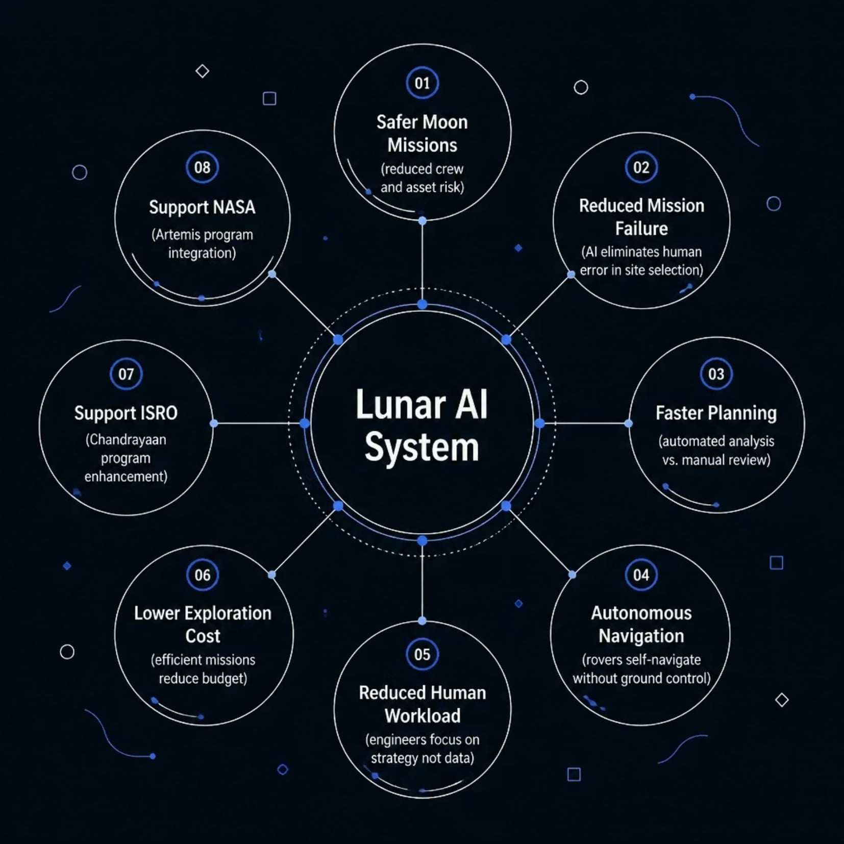

Expected Impact
This system directly addresses the most critical challenges in lunar exploration — from reducing mission failure rates to enabling fully autonomous operations. By automating hazard detection and landing site selection, it dramatically shortens mission planning cycles and lowers operational costs for agencies like ISRO and NASA.
A single successful autonomous landing can save hundreds of millions of dollars in mission costs and years of scientific opportunity.

Slide 17
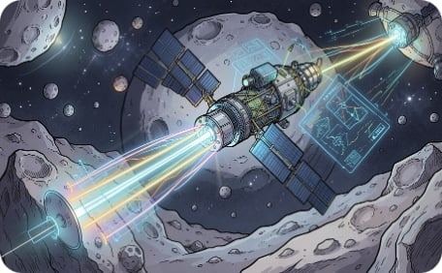
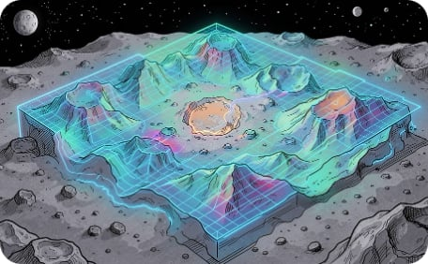
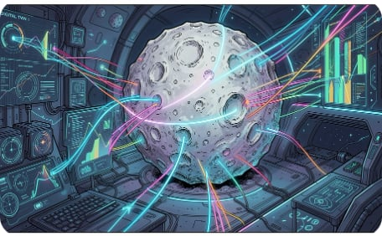
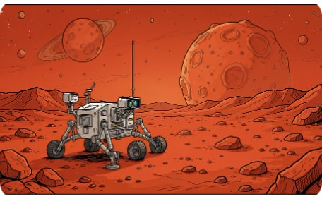
Future Scope
Built to evolve — from lunar landing assistance to a full interplanetary exploration platform.
Real-Time Satellite Link
3D Terrain Mapping
Moon Digital Twin
Mars & Multi-Rover
Full volumetric reconstruction for precision landing analysis
Simulate missions in a virtual lunar replica before launch
Extend to Mars terrain with coordinated multi-rover AI missions
Live terrain feeds from orbiters for dynamic mission updates

Slide 18
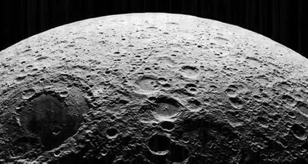
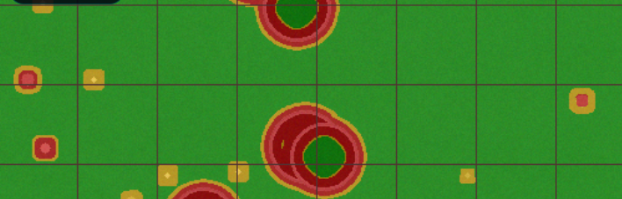
Technical Feasibility
This project is grounded in proven, accessible technology — no speculative components. Every layer of the stack relies on publicly available resources, open-source frameworks, and cloud-native architecture that can be deployed within days.
📦 Public Datasets
NASA , ISRO Chandrayaan imagery freely available
🤖 Pre-Trained Models
YOLO, OpenCV, FLASK, PIL and
segmentation models ready to fine-tune

Slide 19
Implementation Timeline
A focused 6-week sprint from data to deployed dashboard.
Week 1
Week 3
Week 5
Dataset Collection
LROC & Chandrayaan imagery ingestion and labeling
AI Detection
Train crater, rock, and hazard detection models
Path Planning
A* & path finding rover navigation with obstacle avoidance
1
2
3
4
5
6
Week 2
Week 4
Week 6
Image Processing
Preprocessing pipeline, normalization, augmentation
Landing Recommendation
Safety scoring algorithm and zone ranking
Dashboard
Full UI integration, testing, and deployment

Slide 20
Conclusion
Transforming Lunar Exploration with AI
Our solution combines Artificial Intelligence, Computer Vision, and Smart Path Planning to make lunar landing and rover navigation safer, faster, and more reliable.
By automating hazard detection and landing site selection, we can reduce mission risks, save valuable time, and improve exploration efficiency.
Designed using open-source technologies and real NASA/ISRO datasets, the project is practical, scalable, and ready for future enhancements.
Beyond the Moon, the same architecture can support Mars missions and other planetary exploration, making it a future-ready solution.
Final Thought
"The future of space exploration belongs to intelligent systems. With Lunar AI, we're not just helping machines land safely—we're enabling humanity to explore farther, smarter, and with greater confidence."

Slide 21
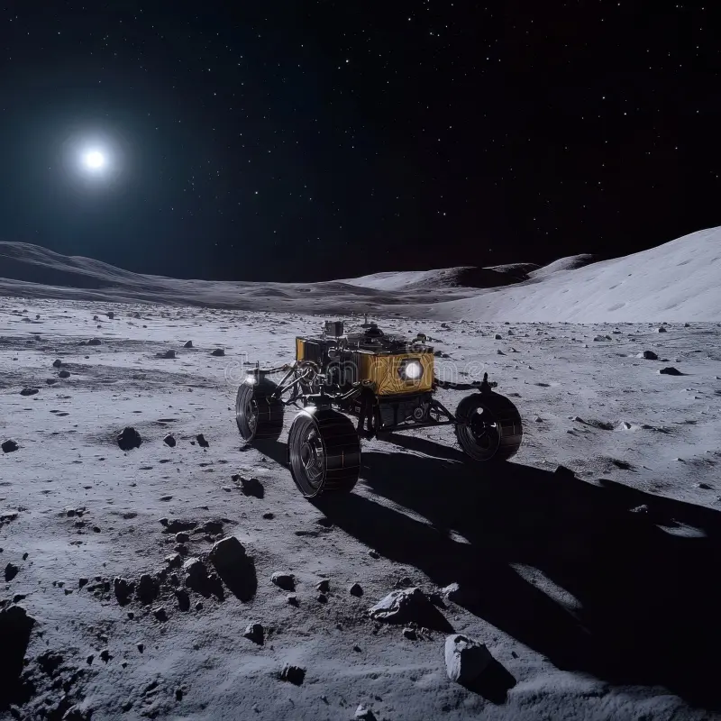
Why Our Solution Will Win
Truly Innovative
End-to-end AI for lunar missions — not just detection, but decision-making
Real-World Ready
Built on proven tech with direct application to ISRO & NASA programs
Infinitely Scalable
From Moon to Mars — the architecture extends to any planetary body
Complete Package
Modern UI, professional architecture, high feasibility, & strong visual impact
This system doesn't just analyze the Moon —
it protects the missions that will one day walk on it.

Slide 22
Thank You!
"Together, let's make the next giant leap in space exploration safer with AI."
Any Questions?
PREV

